Slide 1
INVESTMENT CASE STUDY SUBMISSION
Member name:
Naveen Bharadwaj N

Slide 2
Abstract
Help Spark Investment firm to make data driven investments on different sectors
Approach to data transformation/cleansing
Approach to problem solving
Analysis methods
Solution graphs

Slide 3
Approach to data transformation/cleansing
Use flow chart

Slide 4
Approach to problem solving

Slide 5
Analysis methods

Slide 6
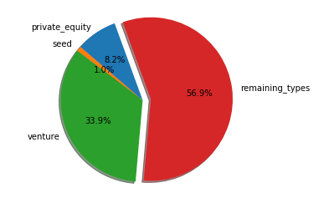
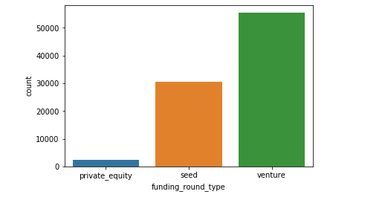
Solution graphs : Plot 1
Fraction of total investments Average amount of investment

Slide 7
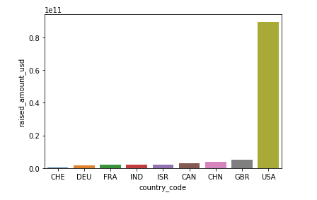
Plot 2
A plot showing the top 9 countries against the total amount of investments on Venture Type

Slide 8
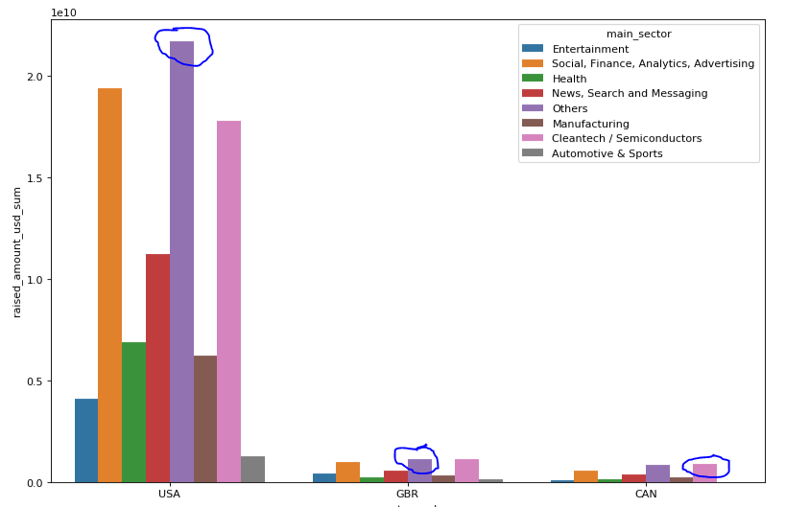
Plot 3
A plot showing investment sectors in Top 3 countries

